Slide 1

Asynchronous programming on the server and the client in F#
Tomas Petricek @tomaspetricek

Slide 2


Slide 3

In Visual Studio since 2010

Slide 4

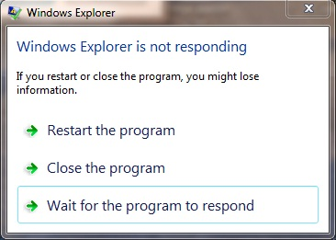
Asynchronous programming
On the server side
On the client side

Slide 5
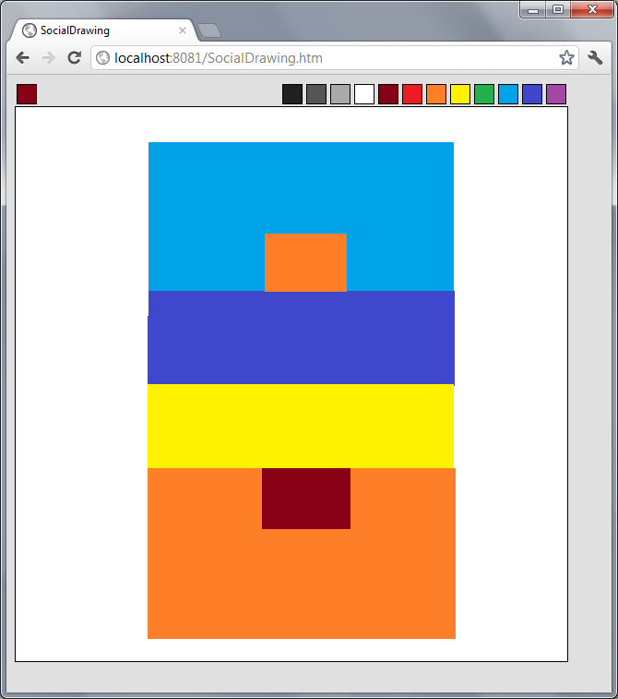
Demo: Social drawing app
Server
Agents
Browser
Client

Slide 6
Async on the Server
Reactive programming without the inversion of control

Slide 7
DEMO
First step
Synchronous to asynchronous
Start processing in thread pool
Exception handling in workflows

Slide 8
Async on the Server
Reactive model is important
Node.js and C# 5.0
F# asynchronous workflows
Keep standard programming model
Standard exception handling and loops
Sequential and parallel composition

Slide 9
Agents and message-passing
Protected * ( Behaviour + State )

Slide 10
DEMO
Second step
F# script files
Writing agents
Agent-based server

Slide 11
F# and the Browser
F# and Silverlight
Both compiler and libraries
Interactive Try F#
F# and JavaScript
Translating since 2006!
Open-source Pit, commercial WebSharper

Slide 12
DEMO
Third step
Running F# as JavaScript
Simple event handling
Using AJAX + JSON

Slide 13
Have fun!
http://tomasp.net/sd

Slide 14
Event handling in F#
Data flow using combinators and control flow using async

Slide 15
Asynchronous GUI
User interactions = State machines

Slide 16
Asynchronous GUI
Updating rectangles
Drawing rectangles
waiting
waiting
up
down
after 500ms
drawing

Slide 17
DEMO
Fourth step
Explain update loop
Implement simple down/up drawing
Using loops or recursion

Slide 18
Asynchronous GUI
Updating rectangles
Drawing rectangles
waiting
waiting
up
down
after 500ms
drawing
move

Slide 19
DEMO
Fourth step (2)
Better drawing of rectangles

Slide 20
What else is there?
F# Interactive in your web browser
www.tryfsharp.org
Type providers in F# 3.0
Integrating data in the language
Bridges an important mismatch
Data and services use REST, XML, …
Languages use types and objects

Slide 21
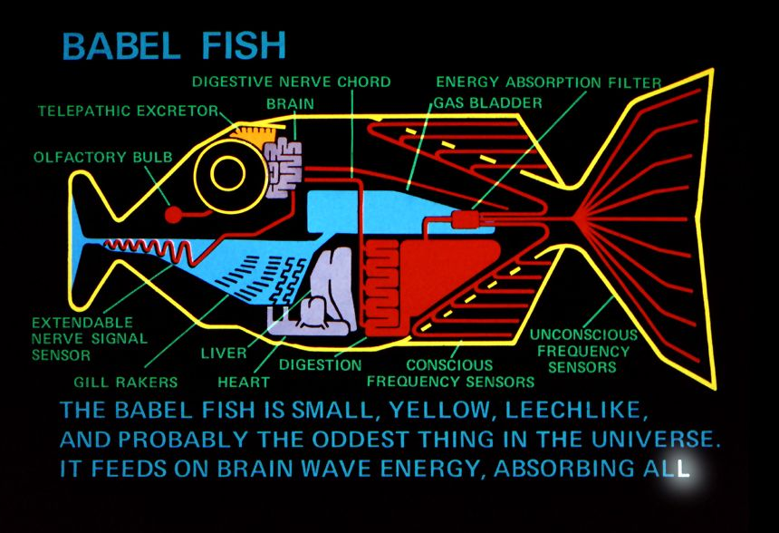
Type providers

Slide 22

Where to learn more?
Functional and F# trainings
http://functional-programming.net
In London and New York
Functional Programming eXchange
http://skillsmatter.com
Next Friday (March 16th)

Slide 23
Summary
Asynchronous programming
Writing non-blocking code
Without the inversion of control
Application areas
Server-side – reactive request processing
Client-side – encoding state machines

